Slide 1

Lincoln University
Registrar’s Office
Registrar: Ms. Maggie (Yiqin) Hua
Room 106, Tel: 510-628-8029 mail: maggiehua@lincolnuca.edu
Assistant to the Registrar: Mr. Faisal Ahmed & Ms. Anjali Shrestha
Registrar’s Office:
Room 107, Tel: 510-250-6112, Fax: 510-250-6114
Email: Registraroffice@lincolnuca.edu

Slide 2
Registrar’s Office Function
Registration 3 times annually*
  Fall semester -16 weeks Official Registration on August 20 – 21, 2020
  Spring semester -16 weeks
  Summer session – 7 weeks (Optional-ongoing student; Required – New student)
  “Academic Calendar” can be found on page 6 - LU Catalog 2019-2020, or website at
  http://file.lincolnuca.edu/catalog/LUCatalog.pdf

Slide 3
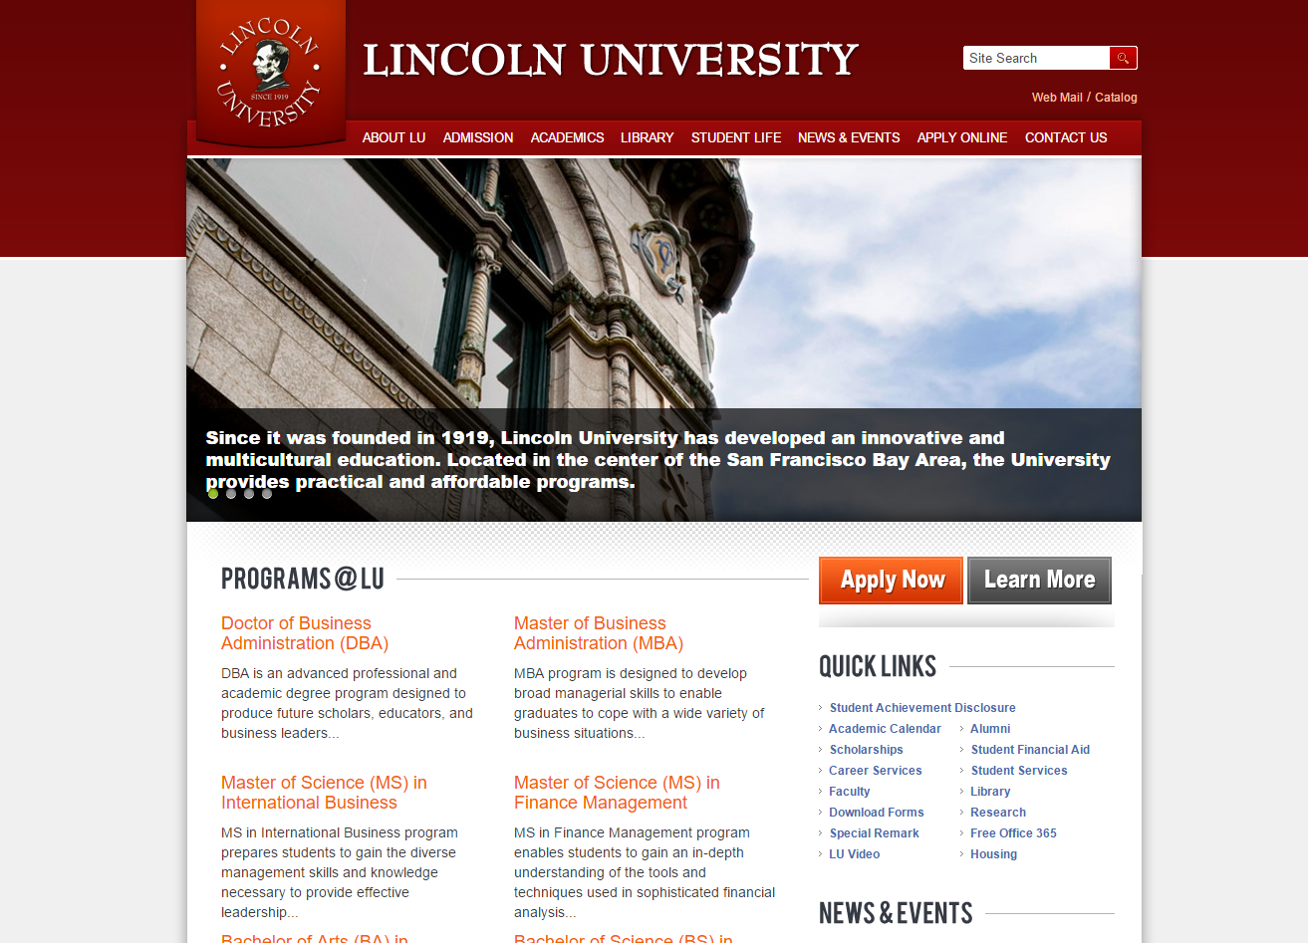
http://www.lincolnuca.edu

Slide 4
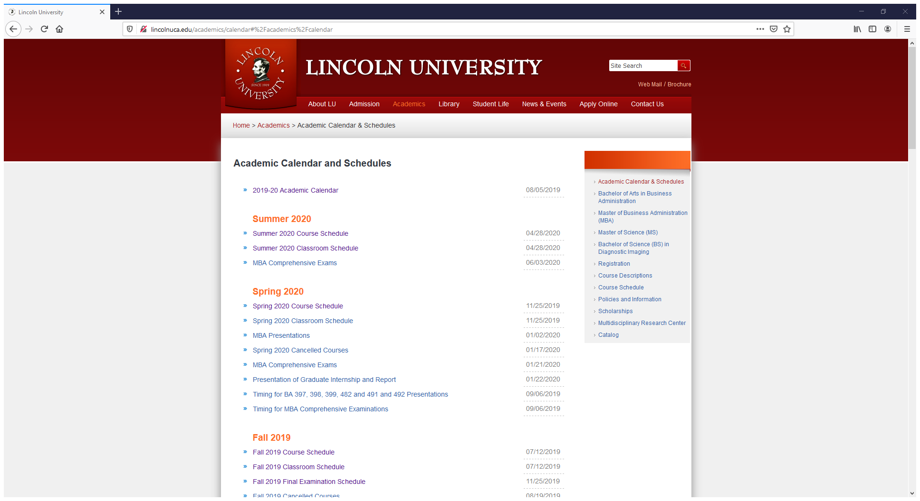
Where can I find the course schedule, classroom schedule and course syllabus?

Slide 5
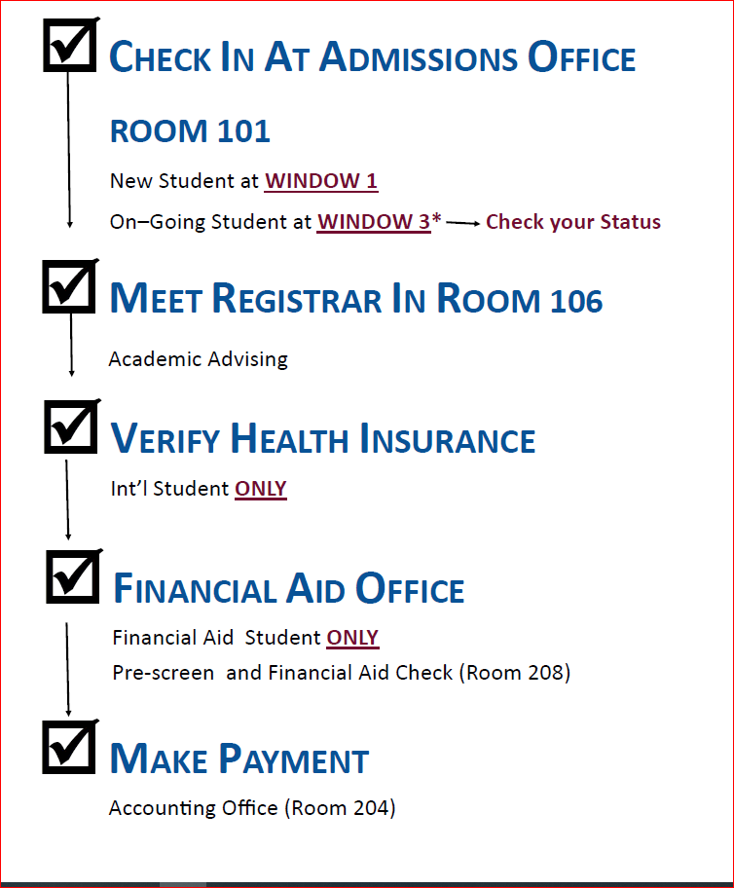
Procedure for Registration on
Official Registration Days

Slide 6
Registration under COVID-19
Returning and new Business and Diagnostic Imaging Department students may schedule online appointment for early registration for Fall 2020 semester through the go.oncehub.com/Fall2020earlyregistration.
15 minutes per student virtual meeting or phone call
On-line process for all departments
Completed registration finalized by payment or payment plan.

Slide 7
PROCEDURE FOR CHANGE IN REGISTRATION (CIR)
Students must complete CIR form; Incomplete forms will not be processed.
Last date to add or drop class(es) on 9/8/2020.
Make a payment to Accounting office.
Return the original CIR form to Room 107
All forms are available online and can be done through emails.

Slide 8
What can Registrar’s Office help you?
Academic Advising
  GPA issue
  Foundation course requirements
  Prerequisite courses
  Transfer units request
  Select the required course for degree program
  Academic related issue
Request transcript and diploma
Changes in Concentration
Change of Address
Schedule Presentation and Exams

Slide 9
Questions and Concerns

